Slide 1
Inheritance and Method Overriding in Java

Slide 2
Inheritance in Java
Java, Inheritance is an important pillar of OOP(Object-Oriented Programming). It is the mechanism in Java by which one class is allowed to inherit the features(fields and methods) of another class. In Java, Inheritance means creating new classes based on existing ones. A class that inherits from another class can reuse the methods and fields of that class. In addition, you can add new fields and methods to your current class as well.
Why Do We Need Java Inheritance?
Code Reusability: The code written in the Superclass is common to all subclasses. Child classes can directly use the parent class code.
Method Overriding: Method Overriding is achievable only through Inheritance. It is one of the ways by which Java achieves Run Time Polymorphism.
Abstraction: The concept of abstract where we do not have to provide all details, is achieved through inheritance. Abstraction only shows the functionality to the user.

Slide 3
Important Terminologies Used in Java Inheritance
Class: Class is a set of objects which shares common characteristics/ behavior and common properties/ attributes. Class is not a real-world entity. It is just a template or blueprint or prototype from which objects are created.
Super Class/Parent Class: The class whose features are inherited is known as a superclass(or a base class or a parent class).
Sub Class/Child Class: The class that inherits the other class is known as a subclass(or a derived class, extended class, or child class). The subclass can add its own fields and methods in addition to the superclass fields and methods.
Reusability: Inheritance supports the concept of “reusability”, i.e. when we want to create a new class and there is already a class that includes some of the code that we want, we can derive our new class from the existing class. By doing this, we are reusing the fields and methods of the existing class.

Slide 4
How to Use Inheritance in Java?
The extends keyword is used for inheritance in Java. Using the extends keyword indicates you are derived from an existing class. In other words, “extends” refers to increased functionality.
Syntax :
class DerivedClass extends BaseClass
{
//methods and fields
}
Java Inheritance Types
Below are the different types of inheritance which are supported by Java.
Single Inheritance
Multilevel Inheritance
Hierarchical Inheritance
Multiple Inheritance (Please note that Java does not support multiple inheritances)
Hybrid Inheritance

Slide 5

1. Single Inheritance
In single inheritance, a sub-class is derived from only one super class. It inherits the properties and behavior of a single-parent class. Sometimes, it is also known as simple inheritance. In the below figure, ‘A’ is a parent class and ‘B’ is a child class. The class ‘B’ inherits all the properties of the class ‘A’.

Slide 6
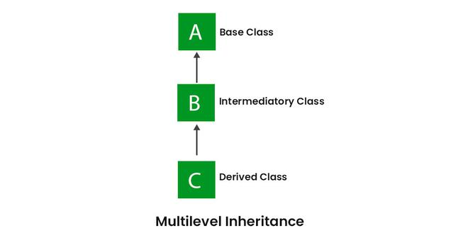
2. Multilevel Inheritance
In Multilevel Inheritance, a derived class will be inheriting a base class, and as well as the derived class also acts as the base class for other classes. In the below image, class A serves as a base class for the derived class B, which in turn serves as a base class for the derived class C. In Java, a class cannot directly access the grandparent’s members.

Slide 7
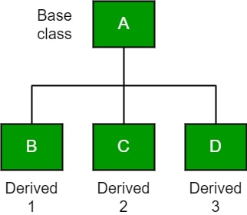
3. Hierarchical Inheritance
In Hierarchical Inheritance, one class serves as a superclass (base class) for more than one subclass. In the below image, class A serves as a base class for the derived classes B, C, and D.

Slide 8
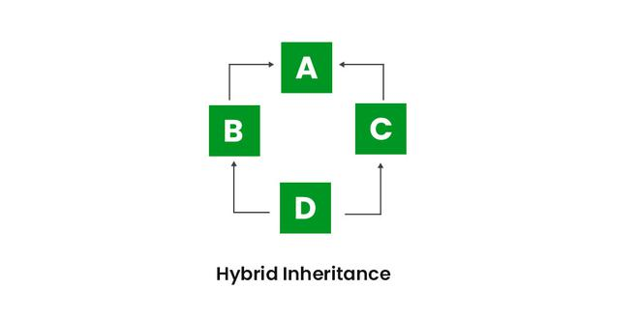
5. Hybrid Inheritance
It is a mix of two or more of the above types of inheritance. Since Java doesn’t support multiple inheritances with classes, hybrid inheritance involving multiple inheritance is also not possible with classes. In Java, we can achieve hybrid inheritance only through Interfaces if we want to involve multiple inheritance to implement Hybrid inheritance. However, it is important to note that Hybrid inheritance does not necessarily require the use of Multiple Inheritance exclusively. It can be achieved through a combination of Multilevel Inheritance and Hierarchical Inheritance with classes, Hierarchical and Single Inheritance with classes. Therefore, it is indeed possible to implement Hybrid inheritance using classes alone, without relying on multiple inheritance type.

Slide 9
What Can Be Done in a Subclass?
In sub-classes we can inherit members as is, replace them, hide them, or supplement them with new members:
The inherited fields can be used directly, just like any other fields.
We can declare new fields in the subclass that are not in the superclass.
The inherited methods can be used directly as they are.
We can write a new instance method in the subclass that has the same signature as the one in the superclass, thus overriding it (as in the example above, toString() method is overridden).
We can write a new static method in the subclass that has the same signature as the one in the superclass, thus hiding it.
We can declare new methods in the subclass that are not in the superclass.
We can write a subclass constructor that invokes the constructor of the superclass, either implicitly or by using the keyword super. (super for variable, super for method, super() for constructor)

Slide 10
Advantages Of Inheritance in Java:
Code Reusability: Inheritance allows for code reuse and reduces the amount of code that needs to be written. The subclass can reuse the properties and methods of the superclass, reducing duplication of code.
Abstraction: Inheritance allows for the creation of abstract classes that define a common interface for a group of related classes. This promotes abstraction and encapsulation, making the code easier to maintain and extend.
Class Hierarchy: Inheritance allows for the creation of a class hierarchy, which can be used to model real-world objects and their relationships.
Polymorphism: Inheritance allows for polymorphism, which is the ability of an object to take on multiple forms. Subclasses can override the methods of the superclass, which allows them to change their behavior in different ways.

Slide 11
Disadvantages of Inheritance in Java:
Complexity: Inheritance can make the code more complex and harder to understand. This is especially true if the inheritance hierarchy is deep or if multiple inheritances is used.
Tight Coupling: Inheritance creates a tight coupling between the superclass and subclass, making it difficult to make changes to the superclass without affecting the subclass.

Slide 12
Conclusion Let us check some important points from the article are mentioned below:
Default superclass: Except Object class, which has no superclass, every class has one and only one direct superclass (single inheritance). In the absence of any other explicit superclass, every class is implicitly a subclass of the Object class.
Superclass can only be one: A superclass can have any number of subclasses. But a subclass can have only one superclass. This is because Java does not support multiple inheritances with classes. Although with interfaces, multiple inheritances are supported by Java.
Inheriting Constructors: A subclass inherits all the members (fields, methods, and nested classes) from its superclass. Constructors are not members, so they are not inherited by subclasses, but the constructor of the superclass can be invoked from the subclass.
Private member inheritance: A subclass does not inherit the private members of its parent class. However, if the superclass has public or protected methods(like getters and setters) for accessing its private fields, these can also be used by the subclass.

Slide 13
References:

